Slide 1

Handling Idioms in Symbolic Multilingual Natural Language Generation
MICHAELLE DUBÉ, FRANÇOIS LAREAU
OLST, Université de Montréal
Notes:
Thank you...
Today I’ll talk to you about idioms in symbolic multilingual NLG.

Slide 2
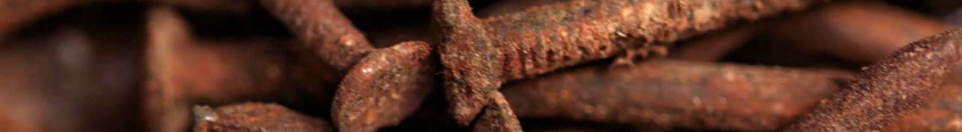
Introduction
IDIOMS IN RULED BASES NLG
Non-compositional MWE
Single unit of meaning
Syntactic structure
Syntactic cohesion
Form flexibility
‘sick’
Sick
˹under the weather˺

Slide 3
Form flexibility
Donner encore sa langue au chat - modifier
‘give up guessing again’, lit. ‘give again one’s tongue to the cat’
Take it with a big grain of salt.
You must take whatever he says with a grain of salt. - complement
He’s just pulling your leg.
˹Lietuvos apeliacinis teismas˺ - inflection
‘court of appeals of Lithuania ’ lit. ‘appellate court of Lithuania’
It was a pretty big bullet to bite

Slide 4

Overview
Linguistic Realizers
Lexical Data
Implementation
Evaluation

Slide 5
Linguistic Realizers
SimpleNLG RealPro JSReal ATML3
KPML Open CCG FLAUBERT FUF/SURGE
MARQUIS FORGe GenDR
LEXICAL CHOICE
OUPUT FLEXIBILITY
SYNTACTIC INPUT
SEMANTIC INPUT

Slide 6
Lexical Data
Linguistic patterns | Example | # | %
N Prep N | tête de mule | 409 | 14%
N Adj | terre ferme | 377 | 13%
Prep N | de justesse | 222 | 8%
N Prep.circ N | corps à corps | 138 | 5%
Adj N | joli coeur | 100 | 4%
Prep Det N | dans le vent | 98 | 3%
V Det N | lever le pied | 97 | 3%
N Prep N | art de la table | 97 | 3%
Others | … | 1417 | 49%
Total |  | 2919 | 100%
French Lexical Network (LN_{fr})
Grammatical classification
Linear syntactic patterns
Sequences of part of speech (POS)

Slide 7

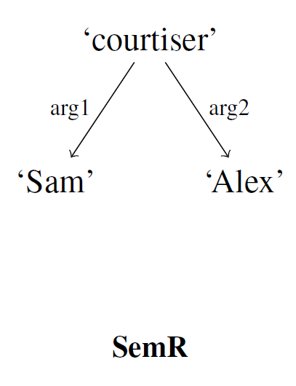
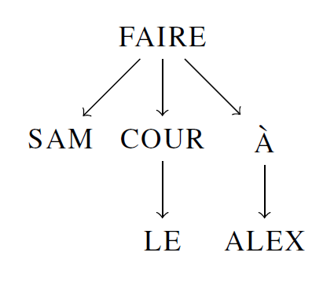
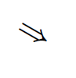
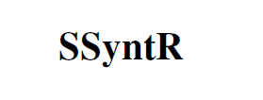
Implementation
Generic deep realizer (GenDR)
Resource sharing
MATE = graph transducer
Meaning-Text theory (MTT)
Semantics-syntax interface

Slide 8
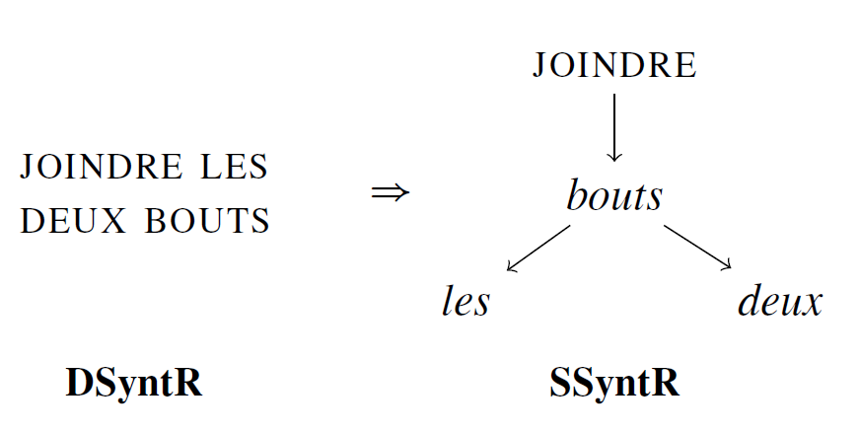
Template Lexicalization Rules
Notes:
Here is an example of such rules. We them called template lexicalization rules because each rule follows a generic patterns and is filled with various lexical data. Each of those rules were automatically generated.
The process of mapping a single DSyntR node onto multiple SSyntR nodes is called template lexicalization within GenDR (Lareau et al., 2018). Figure 2 is an example of such a rule for JOINDRE LES DEUX BOUTS (‘make ends meet’, lit. ‘join the two ends’).¹
A full grammar would require rules like this one for each idiom in a given language. Obviously, a great number of these rules would resemble each other, thus the goal is to generalize them. Our solution is to create a set of template lexicalization rules that generalize Pausé’s linguistic patterns (cf. §3). Each of these rules describes a generic pattern of syntactic tree with placeholders that are filled with lexical stock from our dictionary. The latter is derived from LN_{fr} and enhanced with our own data, as explained below. The idea behind these rules is to generalize linguistic patterns into more generic, language-independent patterns defined by the number of nodes in an idiom’s subtree.
¹Note that we omit relation names from our discussion. The choice of relation names is beyond the scope of our work, since they are language-specific. These decisions are thus left to the lexicographers working on LN_{fr}.

Slide 9
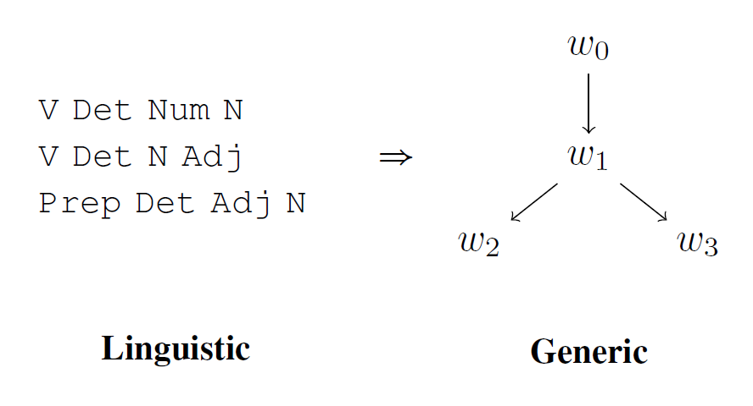
Generic Tree Patterns
˹joindre les deux bouts˺
˹enfoncer une porte ouverte˺
˹dans de beaux draps˺

Slide 10
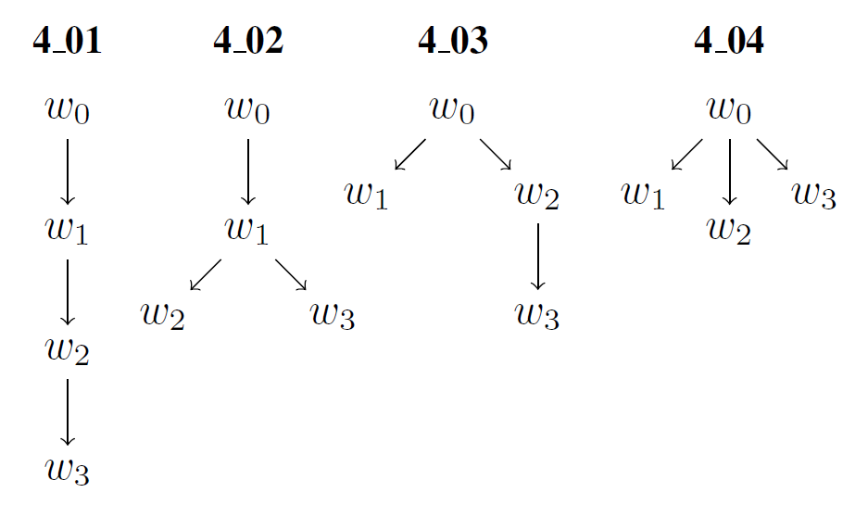
Generic Tree Patterns
 | Partition | # tree
4 nodes | 3 1 + 2 1 + 1 + 1 | 2 1 1 =4
10

Slide 11
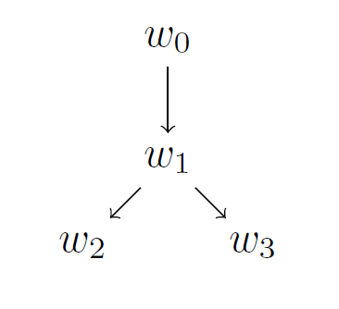
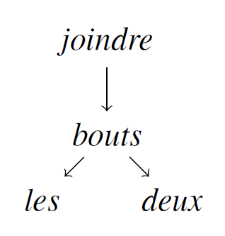
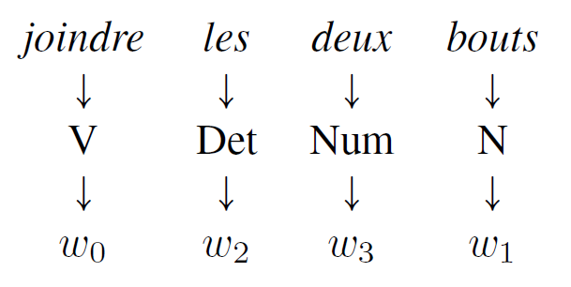
Mapping Patterns
Input | Mapping | Output
V Det Num N

Slide 12

5. Evaluation
5.1 Coverage
5.2 Precision

Slide 13
Results : Coverage
2846
2919
452
514
29
36

Slide 15
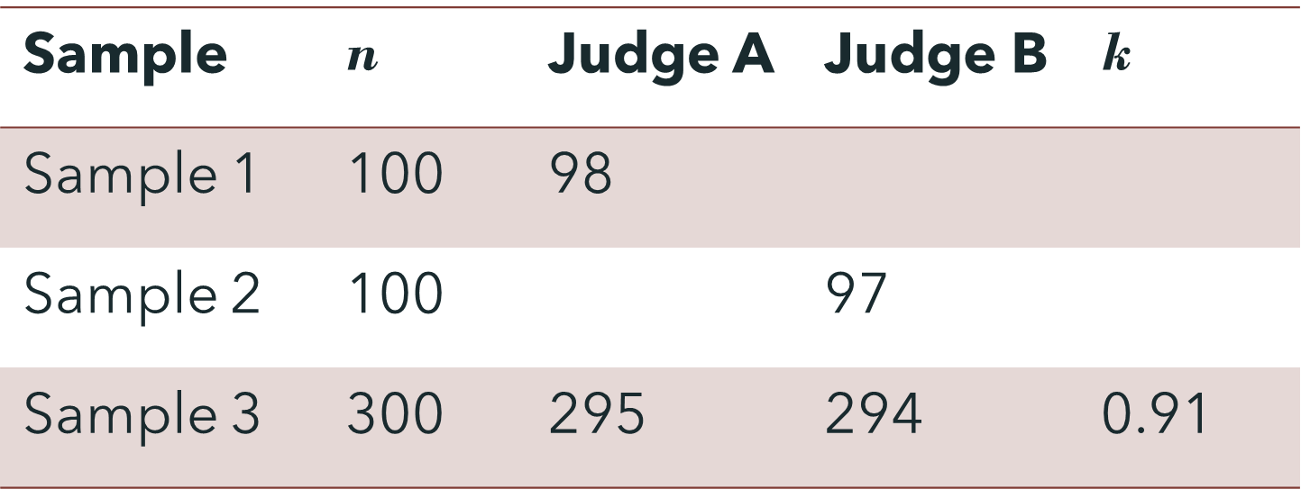
Precision
97.8 % overall precision
PROBLEMS / SOLUTIONS
Pattern mapping
Vague linguistic pattern
Node inflection
Data collection (inflection)
LNfr precision
Government patterns & coreferences

Slide 16
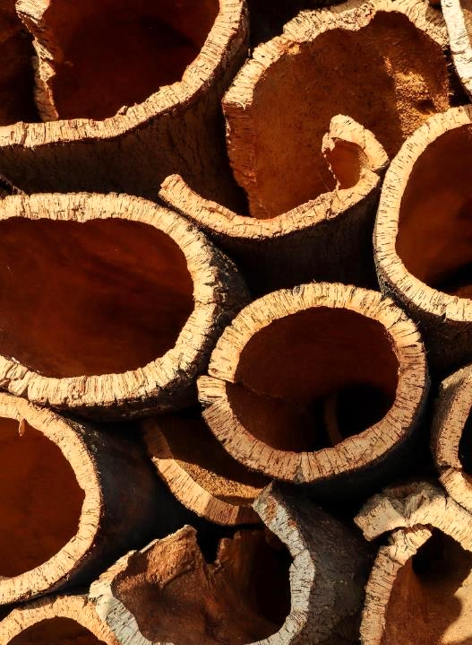
6. Conclusion
Handling MWEs in MNLG
Language independent
Linguistic patterns
Generic patterns
Future work
Graph transducer
GREW
Extend to English and Russian
- LN_{en} LN_{ru}

Slide 17
36
RUSSIAN
MWEs
ENGLISH MWEs
LINGUISTIC PATTERNS
2846 FRENCH IDIOMS
LINGUISTIC PATTERNS
452 LINGUISTIC
PATTERNS
GENERIC
PATTERNS

Slide 18

Thank you
Michaelle Dubé
michaelle.dube@umontreal.ca
www.olst.ling.umontreal.ca

